Slide 1
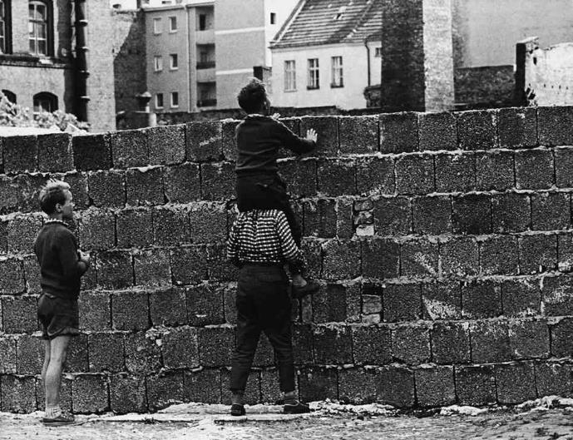
The Middle Cold War: 1953-1979
EQ: How did the events in the middle of the Cold war first cause, then ease tensions between the Americans and the Soviets?

Slide 2
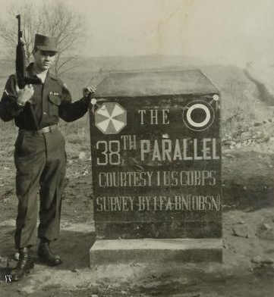
1953: End of the Korean War
Country remains divided at 38th parallel
More than 3 million people died
East (Commie) and West (free) both feel that the war was somewhat futile
China seeks a closer relationship with the Soviet Union

Slide 3
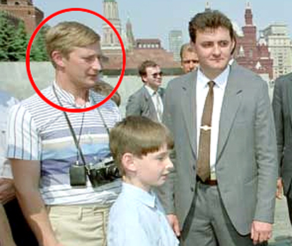
1954: Establishment of the KGB
This Soviet organization is tasked with spying on the western nations during the Cold War
They establish offices in many parts of the world to collect information about the United States and other nations
They, like their American counterpart, the CIA will be responsible for various coups and wars across the globe during the Cold War

Slide 4
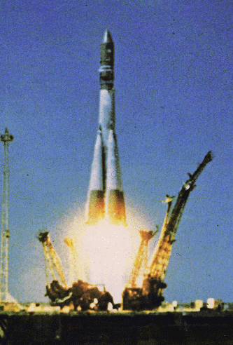
1957: Vostok Rocket Launched 1st ICBM
This rocket would be vital not only to the space race, but also to the use of nuclear weapons
The development of ICBMs deeply intensified the Cold War

Slide 5
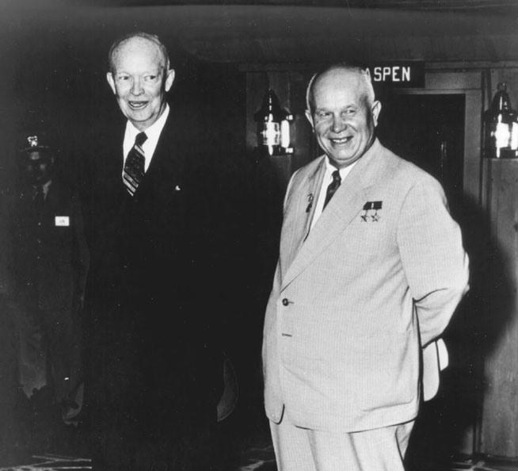
1959: Khrushchev Visits United States
He was the first Soviet leader to visit the United States
He an President Eisenhower made several agreements and agreed to meet the following year in Paris
Unfortunately, this meeting was cancelled after the U-2 incident

Slide 6
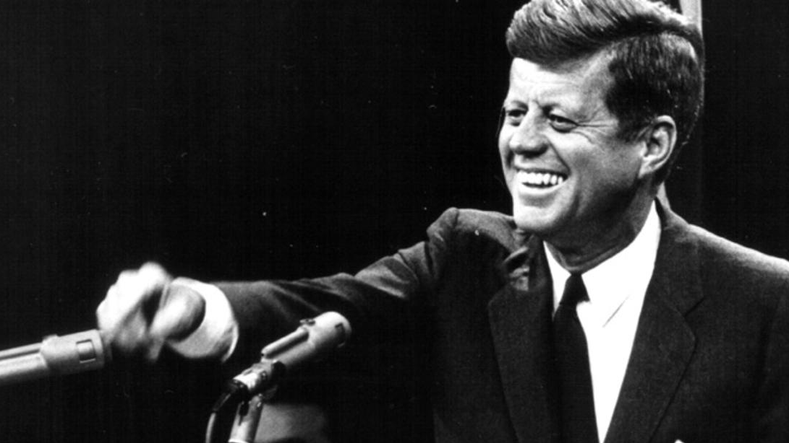
1960: JFK Becomes President
He took a more hardline stance against the Soviets and Khrushchev than Eisenhower
He also took a hard stance against Castro and Cuba
Although he was only president for a short time, Kennedy’s administration would deeply change the course of the Cold War

Slide 7
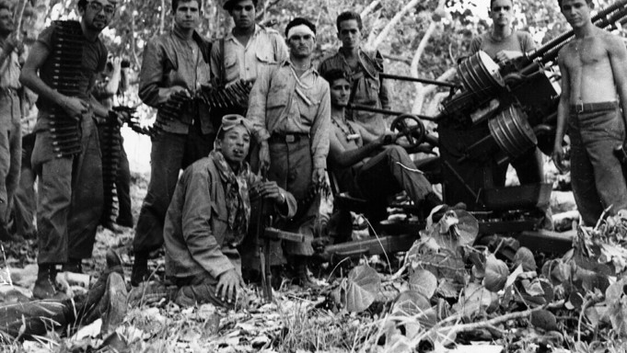
1961: Bay of Pigs Invasion
The CIA, along with the sponsorship of JFK, fail in their bid to overthrow Castro
The previous year, Castro had created a formal alliance with the Soviet Union
The plan for the invasion was to have Cuban dissidents go back to Cuba with the support of the American Navy
The plan failed when Kennedy refused to authorize the use of US aircraft in order to avoid an international incident

Slide 8
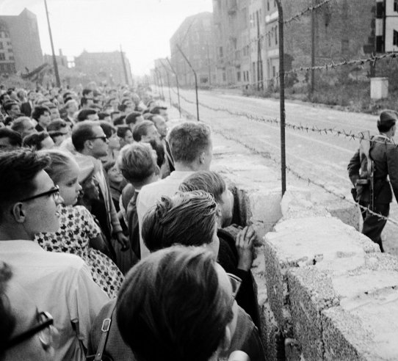
1961: The Berlin Wall Goes Up
The mayor of West Berlin demands American military intervention
Kennedy refused, fearing the response from the Soviets
Later he travels to Berlin and gives his famous “I am a Berliner” speech at the Brandenburg Gate

Slide 9
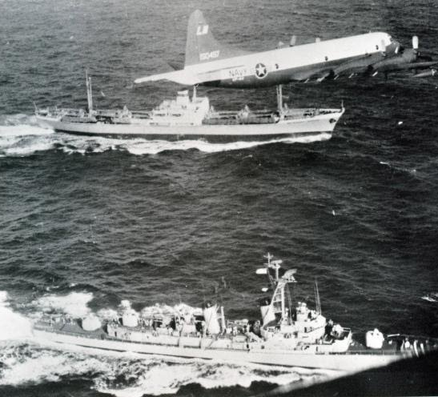
1962: Cuban Missile Crisis
Khrushchev and Kennedy take the world to the brink of Nuclear war over missiles in Cuba
The world holds its breath for 14 days
Kennedy and Khrushchev make a deal where the missiles are removed in return for America taking missiles out of Turkey

Slide 10
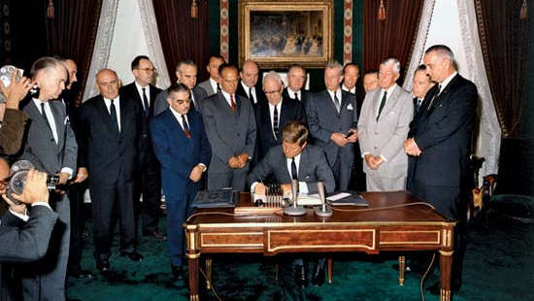
1963: Nuclear Test Ban Treaty:
The United States, Soviet Union, and United Kingdom agreed to not test nuclear weapons above ground, in space, or under water
This was an important agreement in Cold War history and reflected people’s fears surrounding radiation

Slide 11
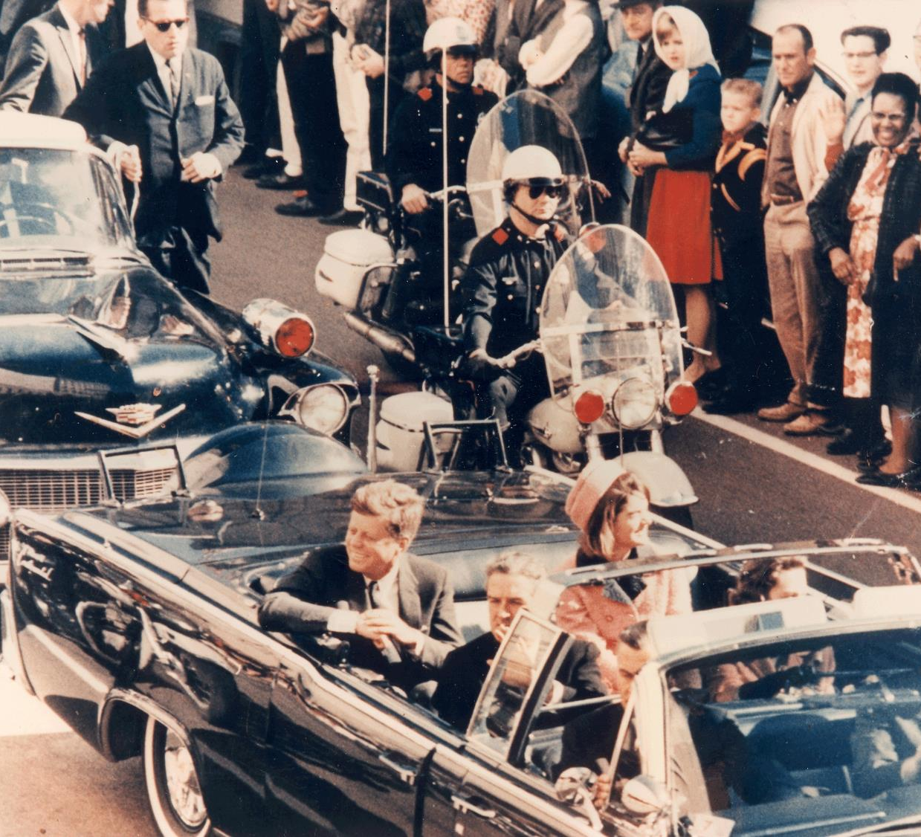
1963: Kennedy Assassinated in Dallas
Kennedy was in Dallas to promote the Democratic party and build up to the election of 1964
He was shot in his car as he traveled through Dealey Plaza by Lee Harvey Oswald
Oswald was killed by Jack Ruby who had connections to the Mafia
This is one of the most contentious moments in American history, but many people blamed the Soviet Union

Slide 12
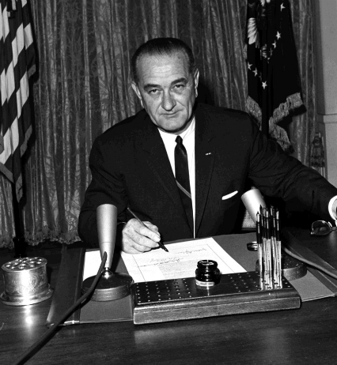
1964: The Gulf of Tonkin Resolution
As the United States became more involved in Vietnam, we sent naval ships to patrol along the coast
On August 4, the USS Maddox was attacked off the coast of North Vietnam
While this incident is shrouded in controversy today, President Lyndon Johnson used this incident to send large-scale American military operations within Vietnam
This was ratified by Congress and began the Vietnam War

Slide 13
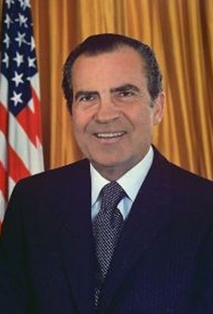
1968: Richard Nixon Becomes President
President Johnson shocked the world when he announced he would not run for re-election
Richard Nixon easily won the election and initially continued to the war in Vietnam and the hardline view of communism

Slide 14
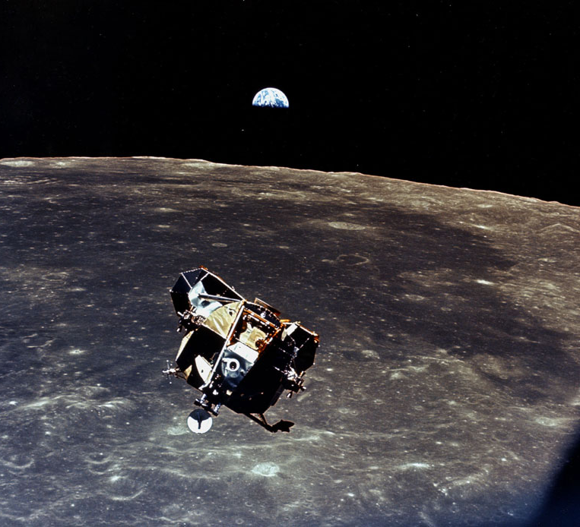
1969: The Man on the Moon
This was the fulfillment of Eisenhower, Kennedy, and NASA’s pledge to surpass the Soviets in space
The Apollo 11 mission landed on the moon, took photos, hit golf balls, and made, “…one small step for man, one giant leap for mankind.”
This was one of the epic accomplishments of humanity and proved that we had better missiles

Slide 15
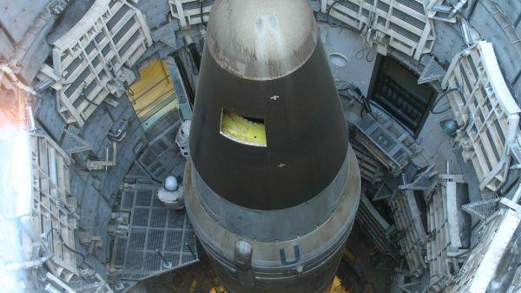
1972: SALT I signed by the United States and Soviet Union
Strategic Arms Limitation Talks I (SALT I) froze the amount of weapons that the Soviets and Americans could deploy and attempted to reduce production of ICBMs
If one side or the other violated the treaty, the other side could build up as well
This helped to ease tensions between the USA and Soviet Union

Slide 16
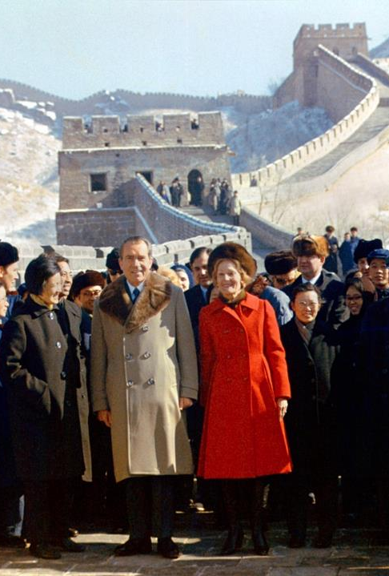
1972: President Nixon Visits China
He signs trade agreements with China and establishes formal relations in 1979
Shortly after this, China and the Soviet Union had a breakdown in relations
This relationship became especially important as China began to emerge as an industrial superpower

Slide 17
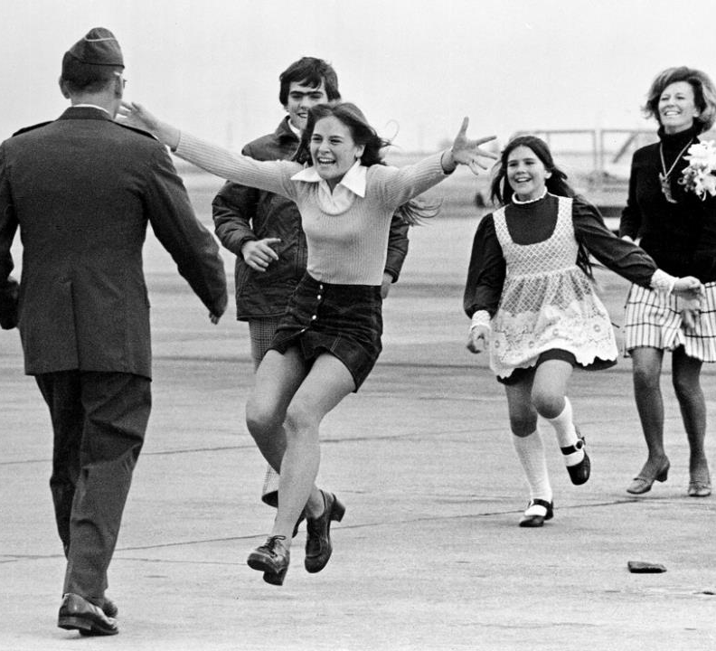
1973: USA Withdraws from Vietnam
As the war in Vietnam claimed more and more lives, public opinion in America began to turn
By 1973, it was apparent that the communists would win
In March 1973, our last troops pulled out of Vietnam
While the war would not end until 1975, President Nixon fulfilled one of his biggest re-election promises

Slide 18
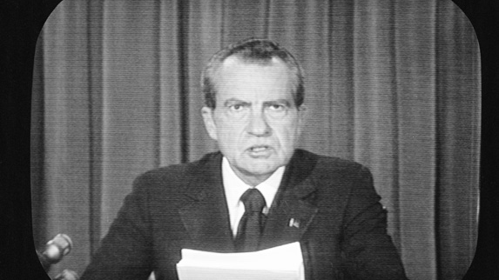
1974: President Nixon Resigns
Nixon had been connected with wire tapping the Democratic offices in the Watergate Hotel in Washington D.C.
He was investigated and brought up on impeachment charges but resigned before he could be tried in congress
Gerald Ford became president

Slide 19
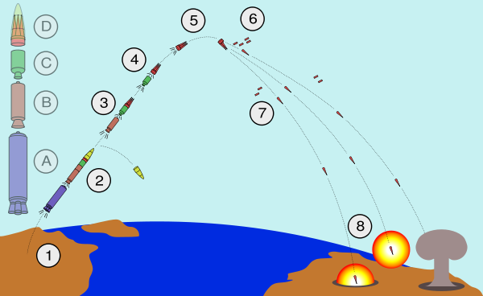
1979: SALT II
SALT 2 attempted to deal with the issue of MIRVs (Multiple Independent Re-entry Vehicles)
Unfortunately, no real agreement could be met
Shortly after this, President Reagan was elected and he drastically changed the relationship between the US and USSR

